Slide 1
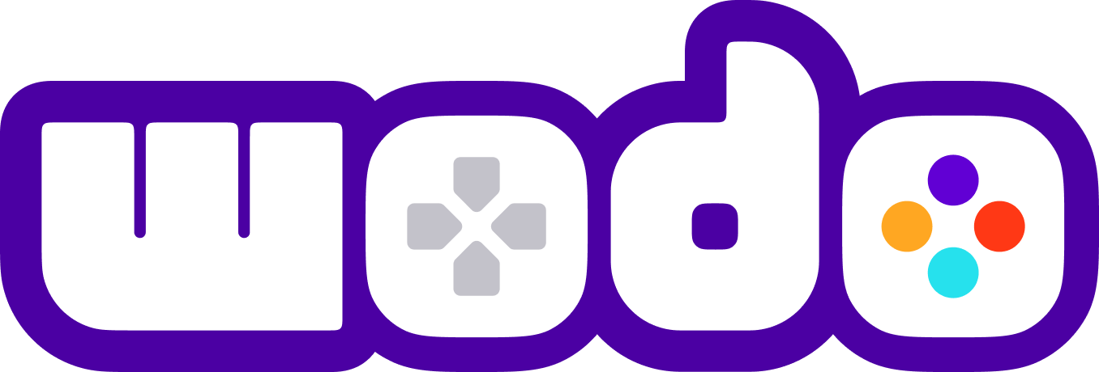
WODO
Blockchain, NFT, Metaverse, Gaming
PLATFORM
WODO
2022
Your gateway to Blockchain, NFT and Metaverse technologies
© 2022. All Rights Reserved

Slide 2
Our vision is to accelerate the transformation of the gaming ecosystem to a new era built around Blockchain and Metaverse technologies and to establish a community as a reference point through curating simple, practical, innovative solutions .
Wodo Gaming
https://docs.wodo.io/wodo-gaming/pitch-deck
Notes:
Wodo Network is Web 3.0 technology company. We want to focus on the gaming industry first since our vision is broad and significant.
Start to talk about Wodo Platform, how we prioritize our vision and solutions then jump to the next slide

Slide 3

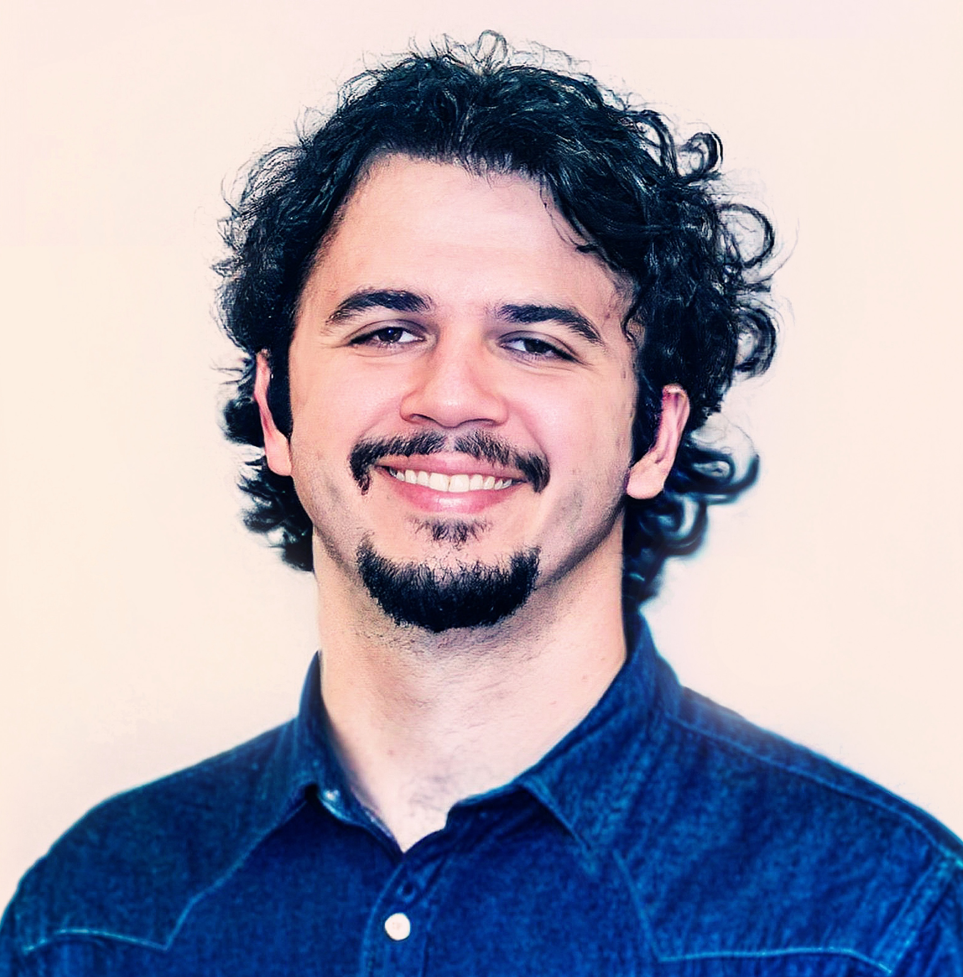

Founders
Bekir Dag
Serhat TANRIKUT
CEO
CTO
19 years of experience in Software Development
Delivered tens of different projects of various sizes in different industries
Started his own web-shop in 2011
Worked for the biggest advertisement agencies in Turkey and built enterprise products such as playstore.com, IKSV.org and secretcv.com
Managed development teams of 10+ people in 3 different software companies in North America and created the standards for support lifecycle. Created tens of different projects from the idea stage to the end product.
Partnered with Student Ally and built the software from scratch with his team, which has a complicated structure and lives on the cloud.
Vast experience in product creation and product life cycle
Founded Wodo Networks as CEO
17 years of experience in Software Development
Walked through many different roles (software engineer, tech team lead, scrum master, release manager, R&D Leader, People Manager)
8 years of leadership experience in Nokia (built international teams, delivered high performant, distributed telco products )
Built/Led market leader device manager/IoT platform for the telecommunication industry in Nokia. 200+ deployments all around the world.
Led SaaS-Cloud Infrastructure Team in Sitecore
Founded Wodo Networks as CTO
Vast experience in leadership, software product development, software architecture, and cloud technologies.
Notes:
Bekir and Serhat met 13 years ago, both have engineering background.

Slide 4

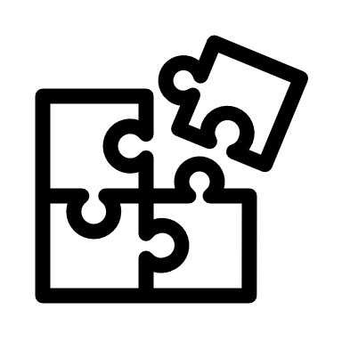
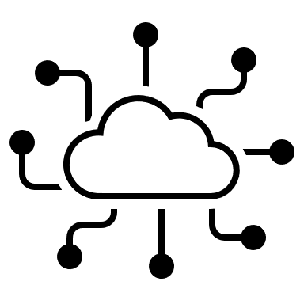
Wodoland
The first blockchain & NFT enabled Mmorpg game leveraging the wodo platform services and gaming solutions.
Play to earn and collect. Demo: https://www.youtube.com/watch?v=QpTORoBwLIs
Solutions
Wodo Gaming
Game Hub, Marketplace, Game Store, Launchpad, Wallet solutions and development kits to adopt blockchain technologies at speed in gaming industry. It is built upon the wodo platform Demo: https://www.youtube.com/watch?v=XlI5Tey1g5M
Wodo Platform
Multitenant, secure, scalable and intelligent platform with blockchain, NFT and metaverse integration services.
Intro: https://www.youtube.com/watch?v=339_rUo_H0U

Slide 5
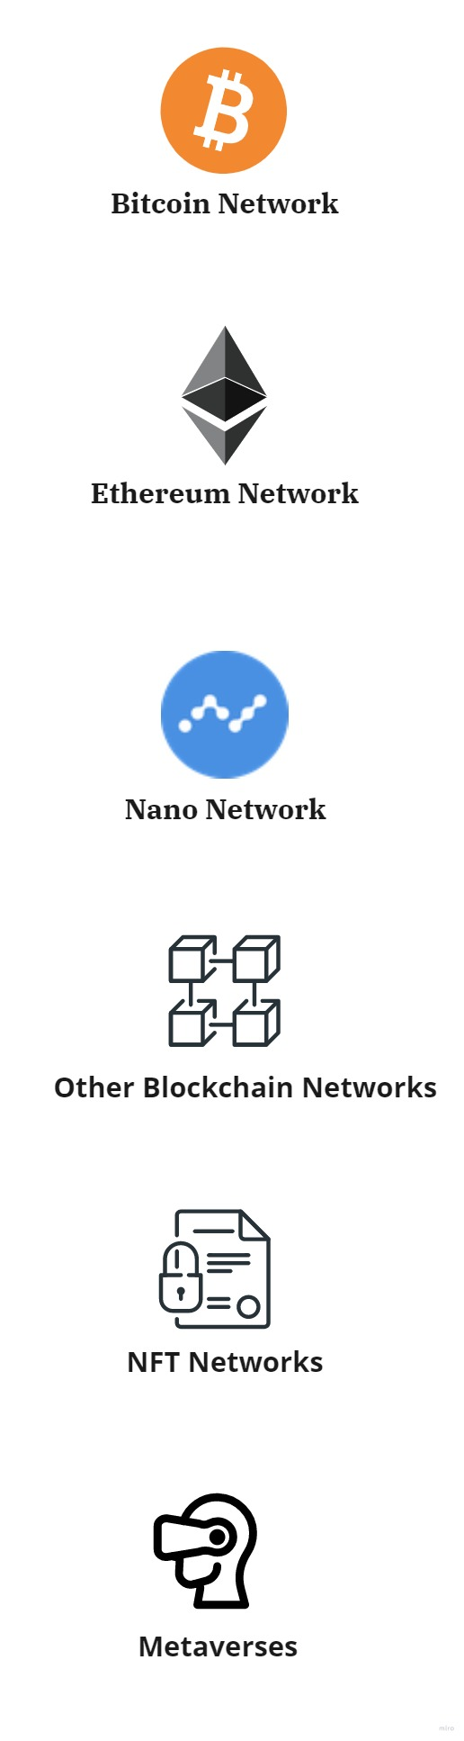
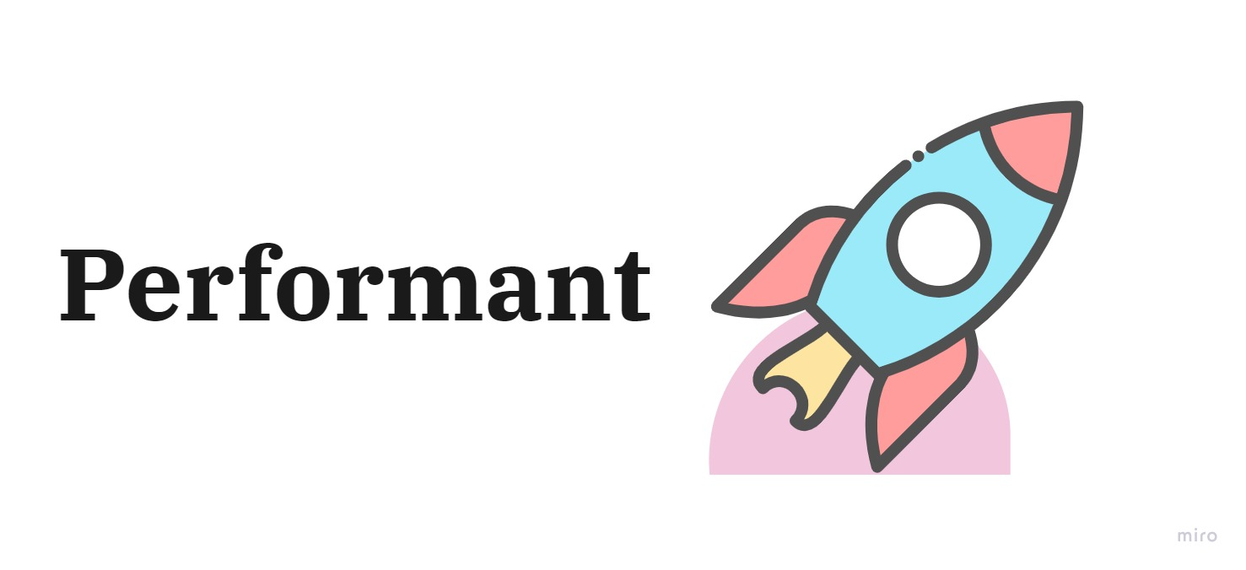
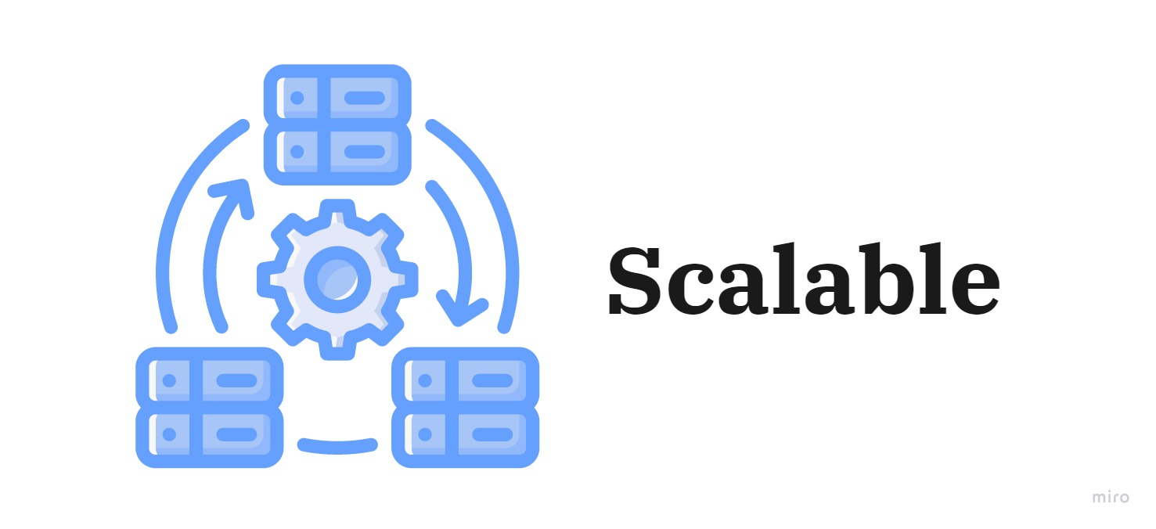
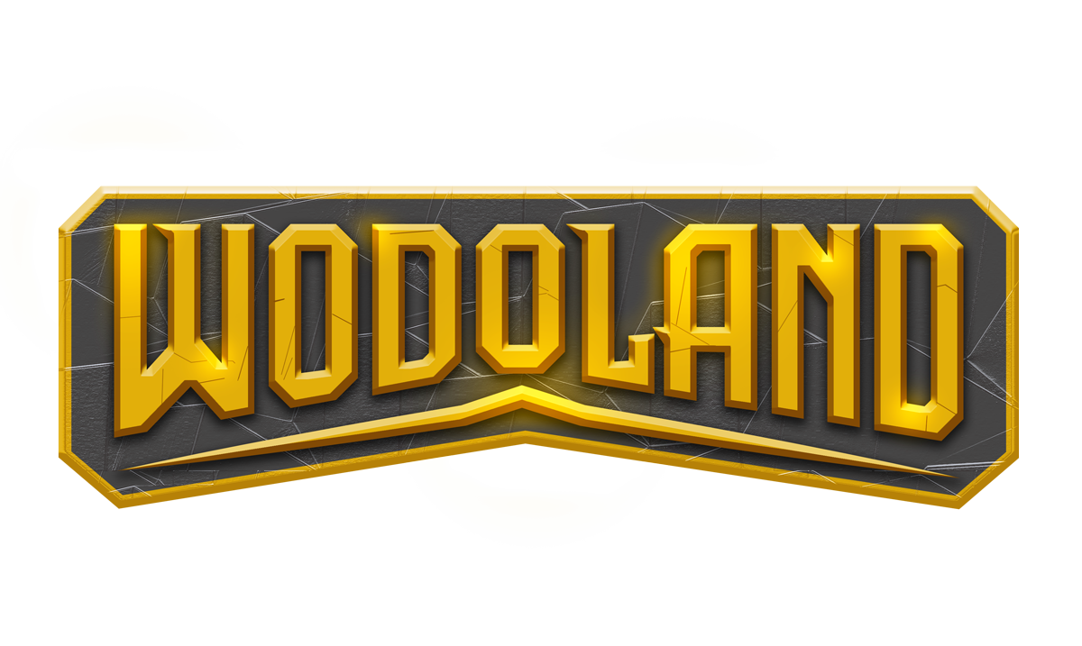


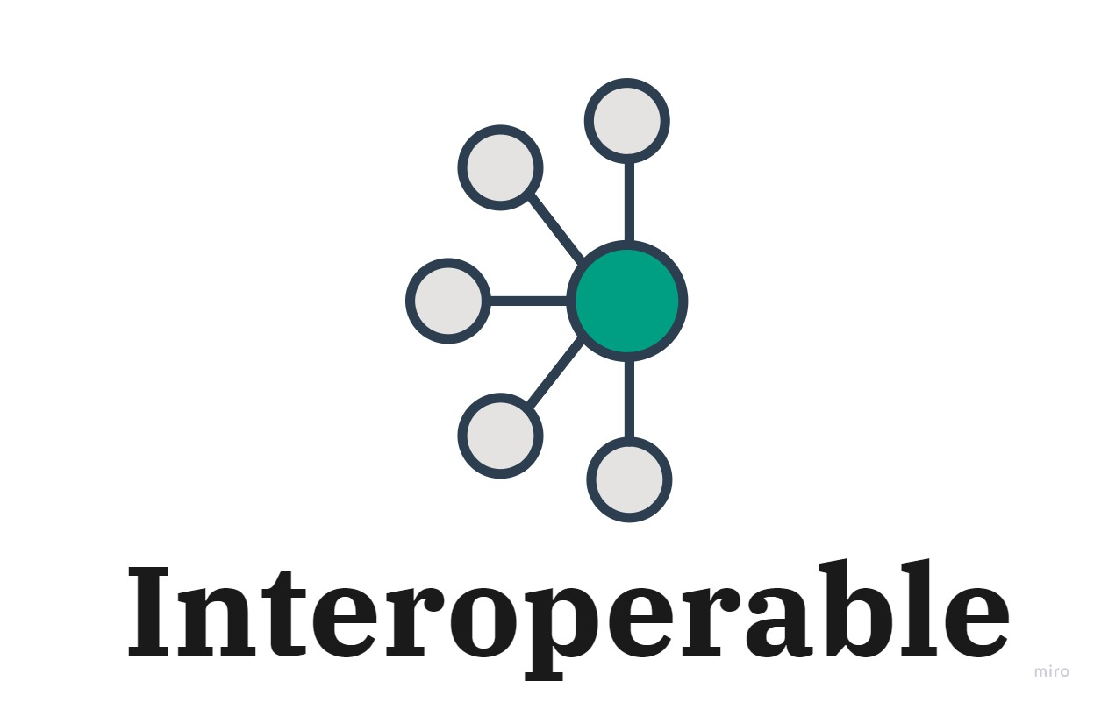
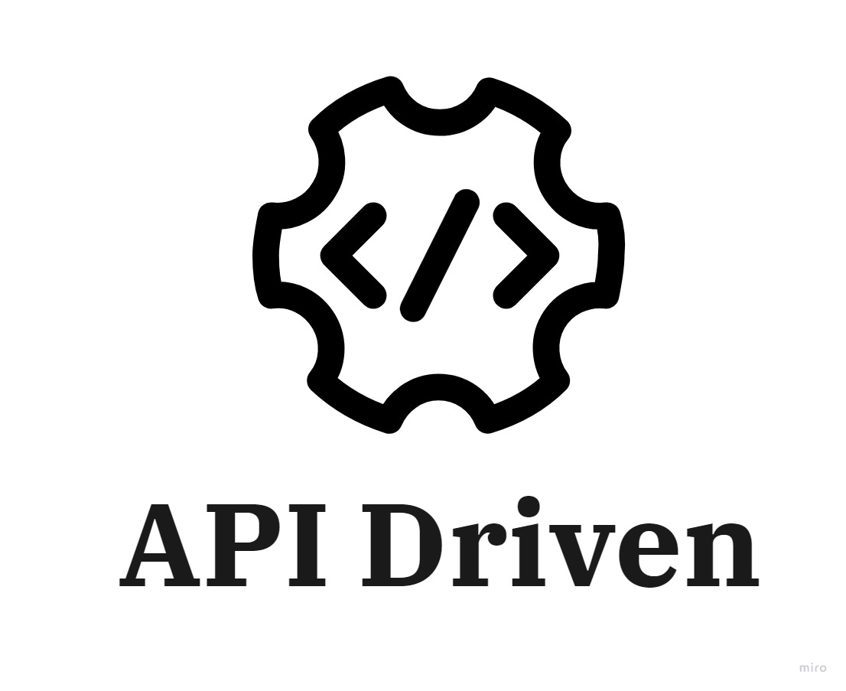
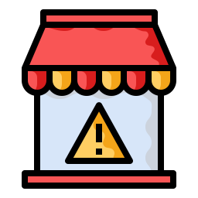


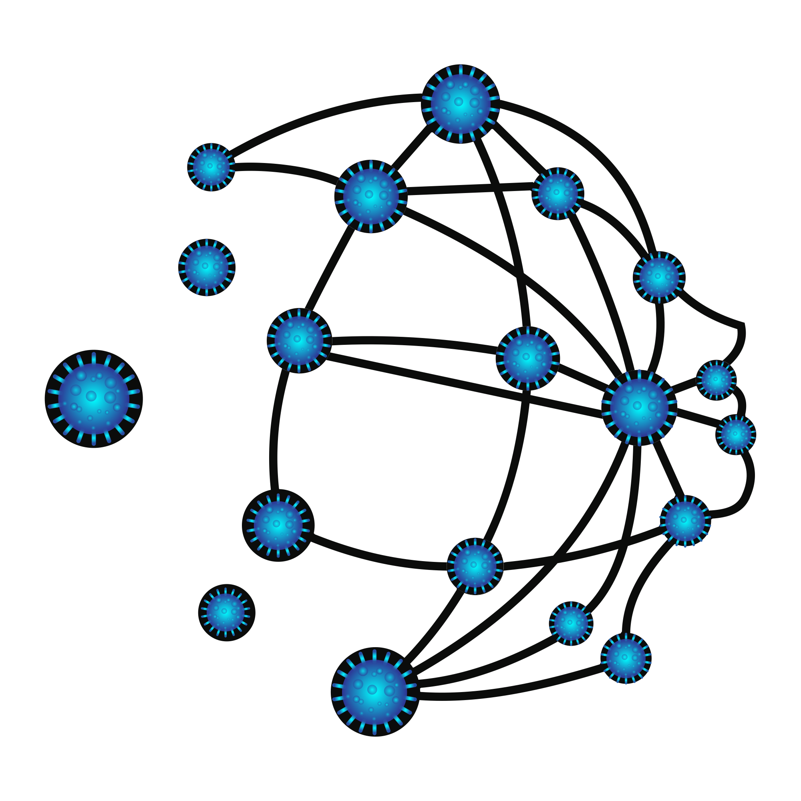

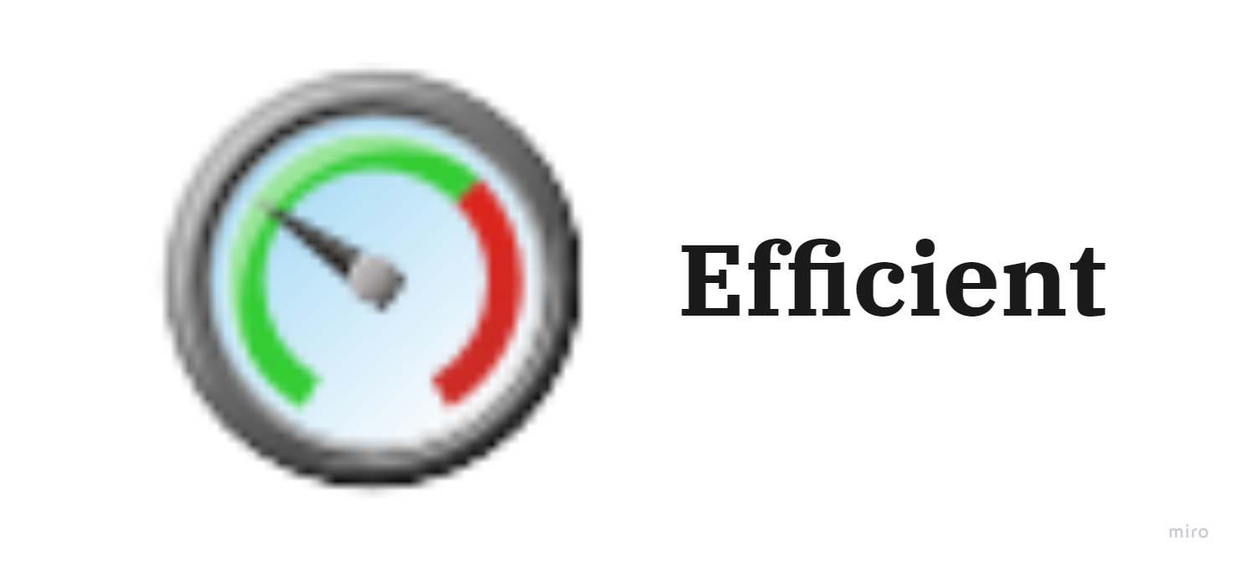
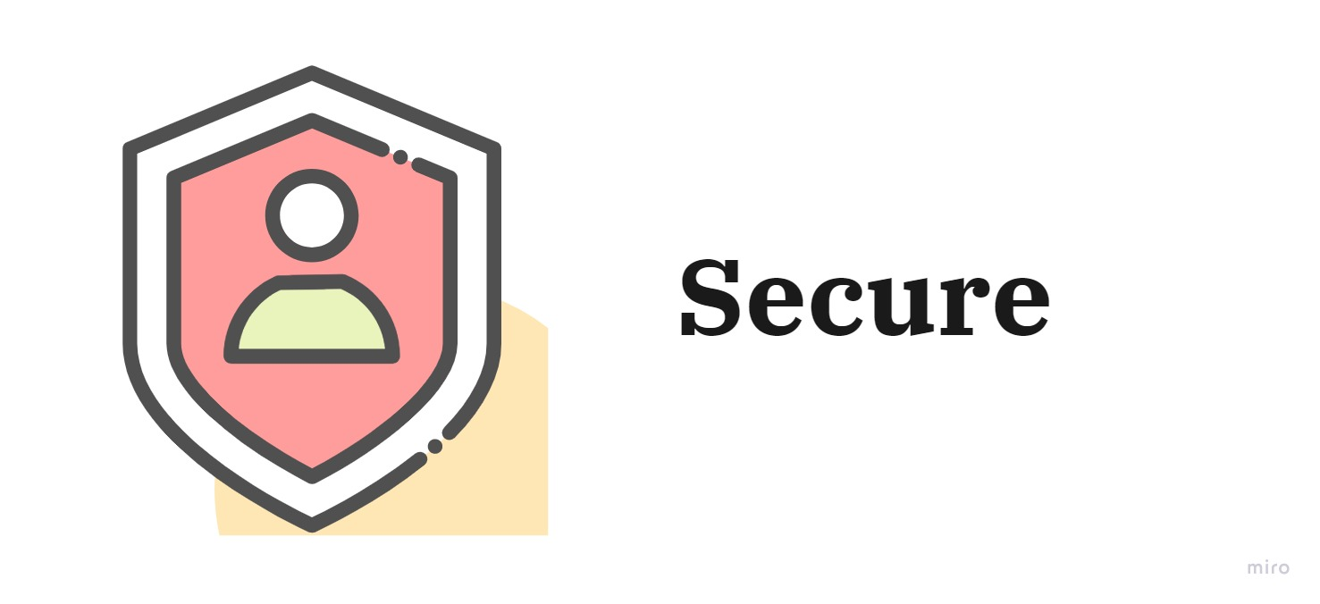
- Solutions
Game Hub
SDKs
Game Store
Launchpad
MMORPG
Fully Integrated with our solutions/APIS
In-Game marketplace
Game Hosting
Marketplace
Wodo Platform
Wodo Gaming
Wodoland Game
Notes:
1- Wodo Platfom: Fundamental pillar of our vision and solutions. Multi-tenant, cloud based, interoperable
2- Wodo Gaming solutions run on the platform
3- Wodoland
Talk about SDKs and Wodo Academy

Slide 6
Easy to Use
We are building smart APIs and Client SDKs for easy integration
WODO PLATFORM
Wodo Platform is built on a cloud SaaS architecture that empowers businesses to do easy cryptocurrency/blockchain, NFT and metaverses integrations into their business use cases rapidly, painlessly through seamless API integrations and automation.
Scalable
The infrastructure is on the cloud so it can scale easily
Business Intelligence
Analytic data with business intelligence, recommendations with AI

Slide 7
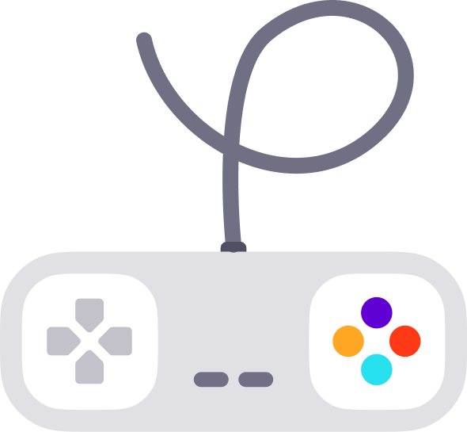
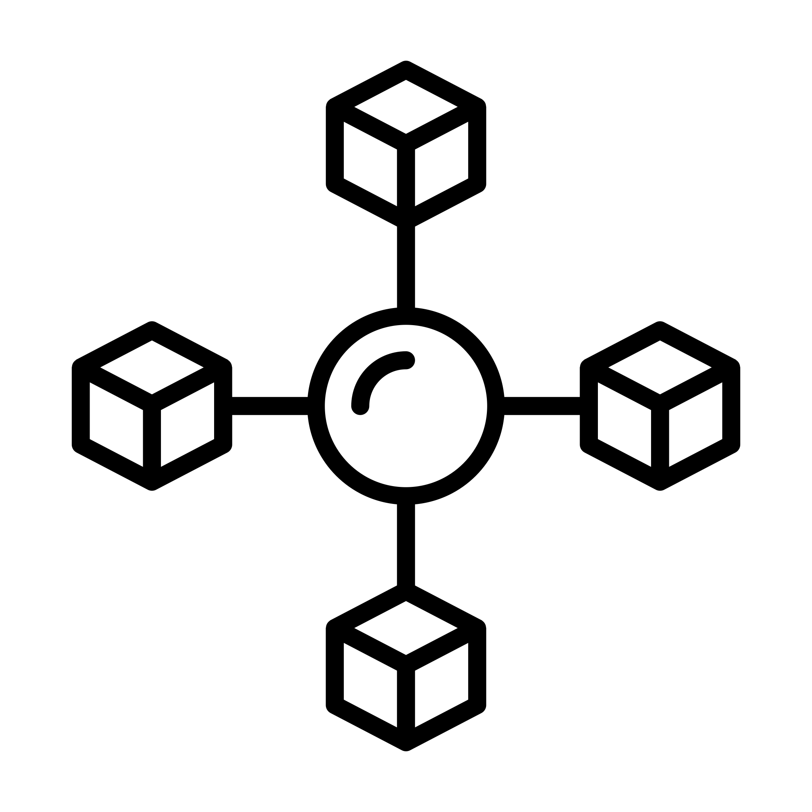
Game Hub
Dev Kits
Game Hub
An active community, online games enriched with cryptocurrency and NFTs
WODO GAMING
Development Platform
Platform APIs, integrations for blockchains, NFT platforms and metaverses. Software development kit for game developers
Game Store
Launchpad
Solutions
Development Platform
Novel solutions – Marketplace, Game Store, Launchpad, Game Hosting
Game Hosting
Marketplace
Notes:
Wodo is a gaming platform where players can join to multi player games of their choice by buying a ticket paid with an instant and feeless crypto currency.
Winners will instantly collect their crypto prizes after the game is finalized.
Take a look at this gaming platform to embrace the idea. Wodo gaming is also a great use case for main Wodo platform usage.

Slide 8
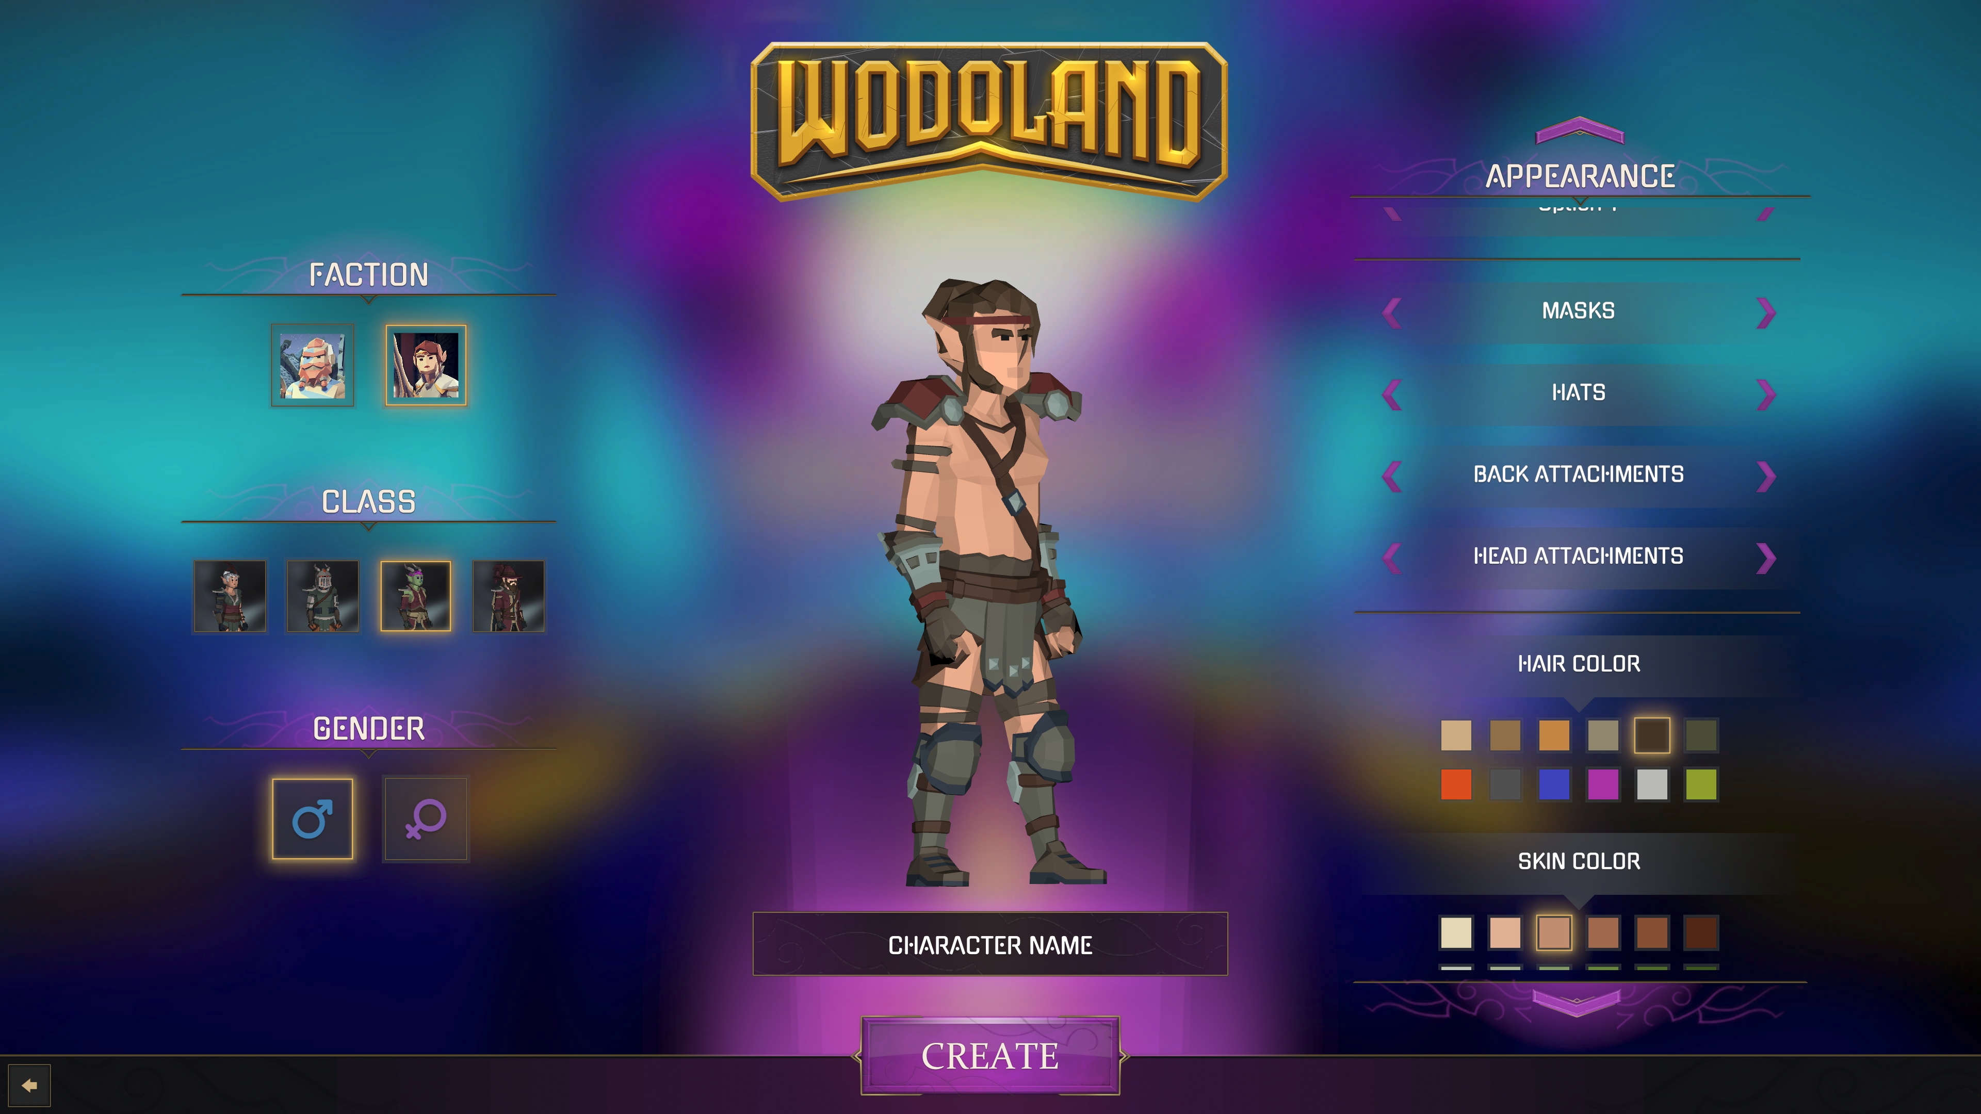
WODOLAND
GAME
First Game Design
In-Game Economics
First Mmorpg and quest-based game design leveraging
the platform services and solutions
Play-to-earn cryptocurrencies and play-to-collect NFTs

Slide 9

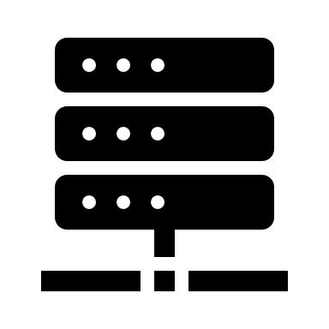




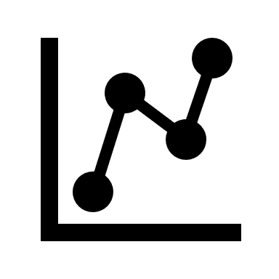
Game Hub/Store
Marketplace
Integration
Beta testing,
Controlled testing,
feedback loops, tunings
Game Hosting
Optional: Low latency, high performance hosting environment
Crowd Funding
Tokenomics,
Launchpad partnerships
Launch
Wodo Gaming
Going live, “zero touch” user registration into Games via Game Hub, active community support, tournaments
Ecosystem
Funding via partnered Launchpads
Built for builders by builders
Development
Idea, Wodo SDK, client libraries,
in-game economics,
Analytics
Live data, statistics for in-game economics, Game Hub, Marketplace, Game Store. Tuning algorithms-AI
Notes:
Wodo Gaming handles end-2-end, full lifecycle of a gaming project by leveraging SDKs and platform APIs, and gaming solutions
1- Based on game type and idea, we offer best in-game economic model and help developers to implement blockchain, NFT and metaverse integration at ease.
2- Once the initial design is done, we offer crowdfunding and an optimum tokenomics model. We plan to establish partnerships with other launchpads to raise money. It is not our whole purpose to operate in the traditional launchpad model.
3- The gaming projects progresses, We provide a stable environment to run beta testing, controlled introduction to the wodo game hub community, feedback loops, performance testing/tunings
4- Optional game hosting for average game projects
5- Going live. Onboarding game-hub community users to the game, listing the game on Game Store, Marketplace
6- Rich insights about the game, exposing data via APIs, Game Hub data, Marketplace data, Game Store data. AI analysis and suggestions

Slide 10
Wodo Gaming Strengths
Unified Gaming Ecosystem for Gamers and Game Developers
Our competitive advantage is that we build our fully integrated solutions(game hub, game store, marketplace, game hosting, dev kits) and platform that allow
- gamers to play any crypto game anytime with their desired cryptocurrency/token (XWGT, Nano, Avax etc..) and monetize their earnings easily using their single crypto account
- game developers to develop and introduce their crypto games to an active community considering all in-game ecenomics in end-2-end manner
Flexible Revenue Streams
Each Wodo Gaming solution has its own revenue stream that also promotes XWGT token holding, e.g; Game Hub has a tournament engine that entertains Wodo Community with variety of crypto games and provides Wodo Network with continuous income/revenue. The strategy strengthens Wodo Network against fluctuating market conditions and XWGT token valuation.
The Team and Vision
The founders and core team have proven expertise and experience in developing complex software platforms and launching software products. It is a leverage to achieve the vision of Wodo Network as a Web 3.0 technology company.

Slide 11




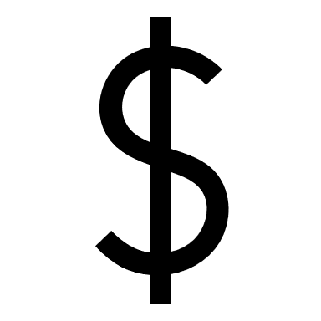


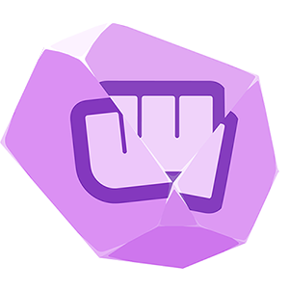
Tokenomics
2%
1%
Advisors
Airdrops
Status: Locked 12 Months
Vesting: 2 years
Status: Locked till listing
Vesting: 2 years
1%
Private Sale
12%
Digital Marketing
Status: Locked, 3 months
Vesting: 5 years
Status: Locked till listing. %6 unlock on listing day Vesting: linear 12 months after exchange listing
Development Team
15%
2%
Public Sale
Status: Locked 12 months
Vesting: 2 years
Status: Locked till listing. %20 unlock on listing day
Vesting: linear 12 months after exchange listing
10%
Strategic
3%
Exchanges
Vesting: linear 12 months
Status: Scheduled
Company Reserves
34%
20%
Play to Earn
Status: Locked 12 Months
Vesting: 2 years
Status: Locked till listing
Vesting: 10 years
Token in Total
1 Billion XWGT - fixed cap

Slide 12

Tokenomics
Token Sales Timeline
% of Total Tokens
Exchange Listing - %3
%6
Exchange Listings
%3
Public Sale - %2
%3
%20 unlock of %2 at listing
12 months linear vesting after 15th of Aug, 2022
%2
%2
Private Sale - %1
%1
%1
%1
%1
%6 unluck of %1 at listing
12 months linear vesting after 15th of Aug. 2022
March
2022
June-July
2022
15th August
2022
Time

Slide 13
Project Info
Web Sites: https://wodo.network/ and https://wodo.io/
Wodoland Game: https://docs.wodo.io/wodo-gaming/ecosystem/wodoland
Main Doc Site: https://docs.wodo.io/
Pitch Deck : https://docs.wodo.io/wodo-gaming/pitch-deck
White Paper: https://docs.wodo.io/wodo-gaming/whitepaper
RoadMap: https://docs.wodo.io/wodo-gaming/roadmap
One Pager: https://www.dropbox.com/s/j7f9fuipwa4oshb/Wodo%20one%20pager.pdf
Wodo Gaming Token: https://bscscan.com/token/0x62D7C4E3566f7f4033fc8e01b4d8e9BBc01c0760
Tokenomics: https://docs.wodo.io/wodo-gaming/tokenomics/wodo-gaming-token
Audit Report: https://docs.wodo.io/wodo-gaming/tokenomics/wodo-gaming-token/audit
Github: https://github.com/wodo-platform
Social Media Links
Twitter -> https://twitter.com/wodoio
Discord -> https://discord.gg/fbyns8Egpb
Telegram -> https://t.me/wodoio
Youtube -> https://www.youtube.com/channel/UCTSRFWbzMYY1lpbSXQSH3Nw
Reddit -> https://www.reddit.com/r/wodoio
Medium -> https://wodoio.medium.com
Linkedin -> https://www.linkedin.com/company/wodonetwork/

Slide 14
Wodo Gaming
Unlimited potential
Web 3.0 is the future with a new digital economic model
Future
Wodo Platform
$ 1400 B
Implement any business use cases
Wodo platform makes it easy and painless to implement any blockchain and metaverse business use cases in agility
Economic value in the upcoming 5 years
WODO NETWORK 2022
14

Slide 15

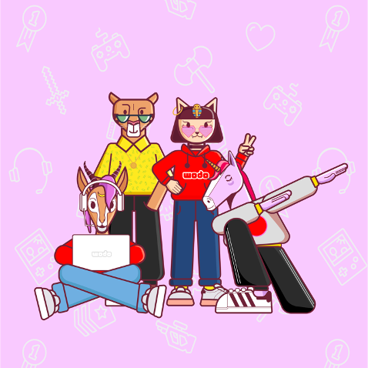
Thank you
Bekir DAG – CEO , bekir@wodo.io
Serhat TANRIKUT – CTO , serhat@wodo.io
+32 470 204 836

